Slide 1
The women in the indentured abolition discourse of C. F. Andrews
Farzana Gounder
Deputy Head of School (Research)
IPU New Zealand Tertiary Institute, New Zealand
Presentation for International web-seminar on International Women’s Day. 8-9 March 2021. Deccan Archaeological and Culture Research Institute, Hyderabad and Shiksha Sanskriti Utthan Niyas, Meerut.
Notes:
Abstract
After the abolition of the British slave trade, Indian indenture was introduced. For 82 years, the institutionalised machinery of indenture provided for the movement of millions of Indians to British, Dutch and French King Sugar colonies around the world. Despite the Indian indenture system’s initial endorsement as an improvement on slavery, there were endemic failings within the system. This presentation analyses the significant role that C.F. Andrews played in bringing attention to the Indian women who worked under the indentured labour system, and the subsequent abolition of the practice of Indian indenture.

Slide 2
Research questions
How was the abolition discourse framed?
How did C.F. Andrews play a significant role in bringing attention to the Indian indentured labour system and the subsequent abolition of the practice of Indian indenture?

Slide 3
Content Layout
Indian indenture overview
Indian indenture in Fiji
The abolitionist movement and discourse on Indian indentured servitude
C.F. Andrews’ role in abolishing the Indian indentured practices

Slide 4
Notes:
After the abolition of the British slave trade, Indian indenture was introduced. The Indian indenture system occurred from 1830-1916.
Indenture, a means of utilising cheap, guaranteed labour, was an essential tool for empire-building; its machinery borrowed heavily from institutionalised practices established during the slavery period (Batsha 2017; Kale 2010).
For 82 years, the institutionalised machinery of indenture provided for the movement of millions of Indians to British, Dutch and French King Sugar colonies around the world. The first trial of the Indian indenture scheme started in the colony of Mauritius in 1834, bringing some 453,063 migrants. Other colonies followed, as we can see from the map, and Fiji (1879 with 60,965 migrants) (Lal 2000), which is where I come from, was the last.

Slide 5
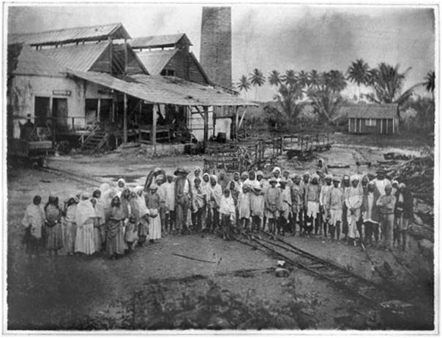
Notes:
The majority of the Indian labourers came from the United Provinces (UP) and were often familiar with agricultural work, indicating a farming background for many, though not all. The impetus to become indentured was due to several factors. The push factors were a combination of high debt burden for peasants because of the colonial land tenure policy, crop failure, poor weather conditions (such as droughts, poor monsoon season), famine, and landowners’ demands. These factors drove peasants out of the farming areas, particularly in UP, creating a system of internal migration within India towards the East, where they worked as unskilled labourers in mills, factories, docks, coal mines, on roads and railways, or harvesting crops, such as jhute. These internal migrants would then send remittances home, creating an essential economic backbone for their families. It is thought that these internal migrants formed the bulk of the indentured labourers. These individuals, already on the move in search of work, were persuaded by recruiters to work in the colonies for higher wages than in India. The internal migrants, thus, became trans-migrants (Gillion 1962).

Slide 6
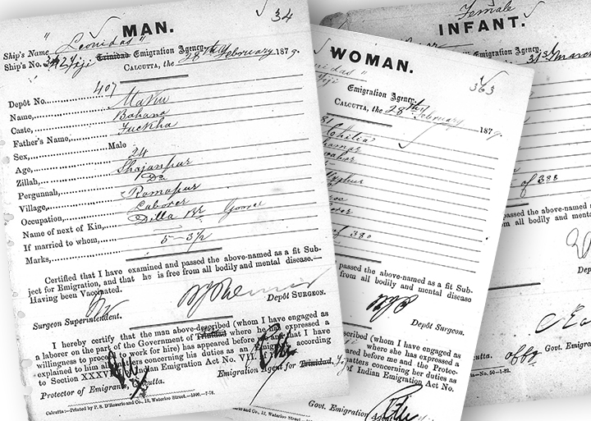
Notes:
The indenture system had a far-reaching impact. For 82 years, the global machinery of indenture turned peasants into labourers. It also created employment for the officials of indenture not only in India but also on the ships and in the colonies. In addition, it provided employment to shipping companies, and it even utilised ex-indentured labourers, returning to India, where they became recruiters of the uninitiated.
Moreover, there were complex, interlocking wheels that impacted the lives of the labourers. There was the global machinery of indenture (systems and processes that extended from India, across the oceans and into the colonies), which interacted with governance (state regulations on law and order), which, in turn, interacted with planters’ concerns and demands, and the labourers’ welfare (social, psychological, physiological and economic states of being).

Slide 7
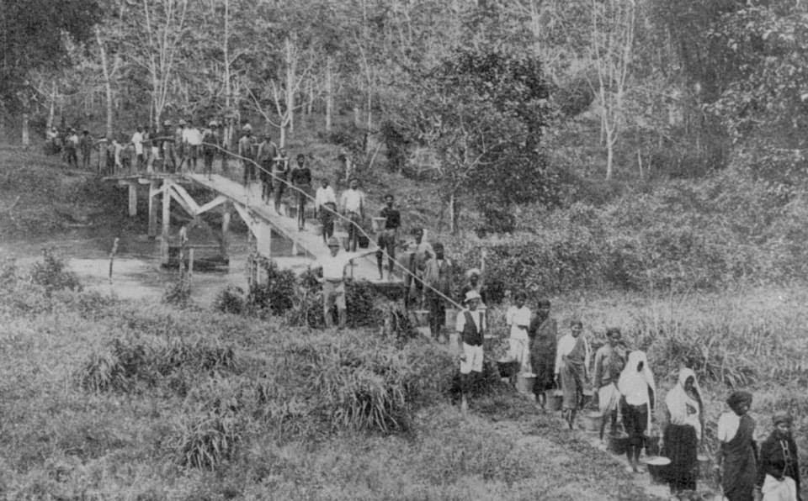
Notes:
Hugh Tinker (1974) has famously likened indenture to slavery. This view has some merit, particularly in the early years, where the same slave owners were now utilising indentured labourers on their plantations (Kale 2010). Indeed, the major push for indenture was to fill the shortage of cheap, guaranteed and compliant labour due to the abolition of slavery. The initiative was an economic success for the colonial planters, and, over time, Indian indenture was utilised in places which did not have a history of slavery, such as Natal and Fiji (Vahed & Desai 2012).
Of course, conditions did improve over the duration of the indenture era, and we can see this in the case of Fiji, the last importer of indentured labourers, where there was an increase in room sizes over time, a separate area for cooking outside the living facilities, and the removal of task-based payment. But it must also be said that in the eyes of the world (the Indian and British public spheres), the systems and processes of indenture and the welfare of the indentured labourers were not sufficiently improved to allow for the continuation of the system (Andrews & Pearson 1916).

Slide 8
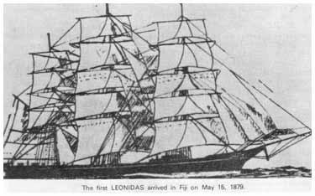
Notes:
Out of all the colonies, Fiji has always been of great interest to scholars, particularly because of the role that the colony played in drawing attention to the lives of the labourers. Some of the labourers were themselves instrumental in the abolition of indentured servitude, and also, the abolitionists, such as C.F. Andrews used Fiji as an exemplar to draw attention to the lives of the workers.
If we look at the discourse condemning Indian indenture, the focus is always on Fiji, whether this is seen in Totaram Sanadhya’s writings, the public sphere discussions of women such as the labourer Kunti… and also the abolitionists, C.F. Andrews and Pearson.
So, let us take a closer look at Fiji’s indenture system as a case study.
Indenture in Fiji began in 1879. Approximately 60,000 people went to work in Fiji under Indian indenture. The majority came from the United Provinces.
And from this area, most came from Bihar and its surroundings.
Towards the end of indenture, recruitment also extended to South India.

Slide 9
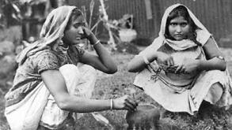
Notes:
The terms of contract for Indian indenture in Fiji stipulated the following:
The period of service was five years from the date of arrival. Upon their arrival on the colonial plantation, labourers were to receive rations from the employers for the first six months at government prescribed rates of 4 pence, deducted from the labourers’ wages. Provisions were also made for families: For the first year, children between the ages of 5 and 12 were to receive half the daily ration, while those under 5 years of age were to receive 9 chittacks of milk daily.

Slide 10
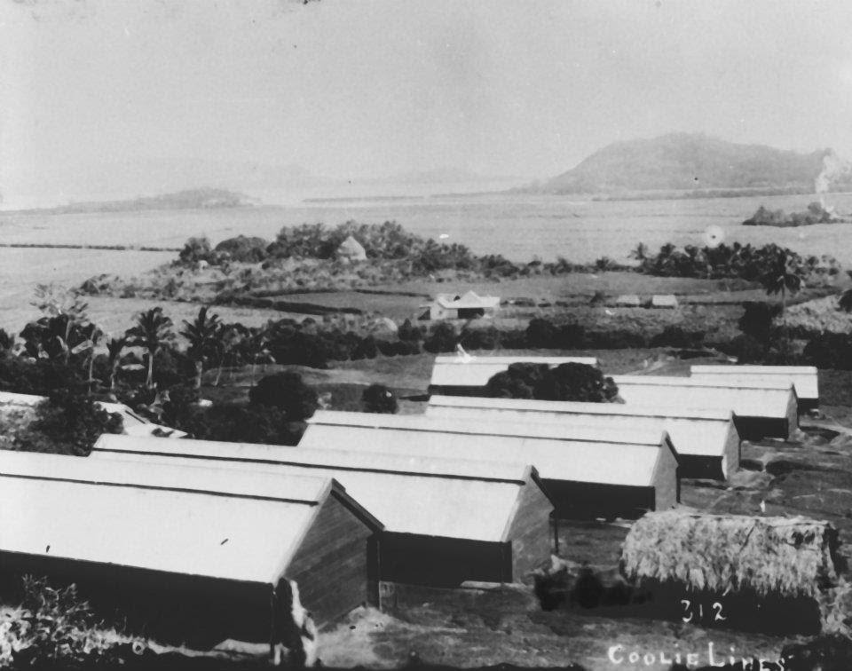
Notes:
Employers were required to provide the labourers with suitable, rent-free dwellings in good repair. Labourers were required to work 9 hours per weekday and 5 hours on Saturdays. Sundays and authorized holidays were designated as rest days. Wages were to be paid monthly, weekly or by task. For task based work, all adult males were to receive 1 shilling or more for completion of task in six hours of steady work, women received nine pence or more for four and a half hours of work, and children were paid according to the work performed. If labourers were required to perform extra work, they were to be paid accordingly. Medical provisions were also made for those who were ill. They were to be provided with hospital accommodation, medicines and food free of charge. On completion of 5 years of indenture, emigrants could return to India at their own expense. The labourers also had the choice of reindenturing themselves for another 5 years after which they could choose to return to India, with a free passage or they could remain in the colony, and lease land from the Colonial Government.

Slide 11
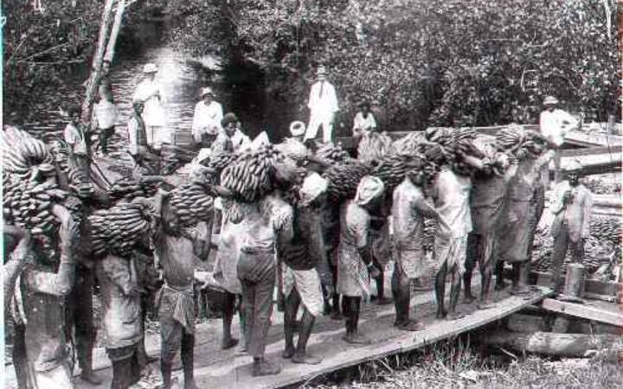
Notes:
Indian indenture in Fiji: why is this a significant case study of the indentured labour period
As I mentioned earlier, Fiji was the last colony to which indenture was introduced, and it is possibly the reason why the ills found to be present in Fiji were even more concerning.
Reports drew attention to the workers living conditions, pay disparity, working conditions, the high rates of violence, suicide, morbidity and mortality rates through diseases.

Slide 12
ANDREW’S ASSESSMENT OF THE FAILINGS OF THE INDIAN INDENTURED LABOUR SYSTEM: A MORAL DISCOURSE

Slide 13
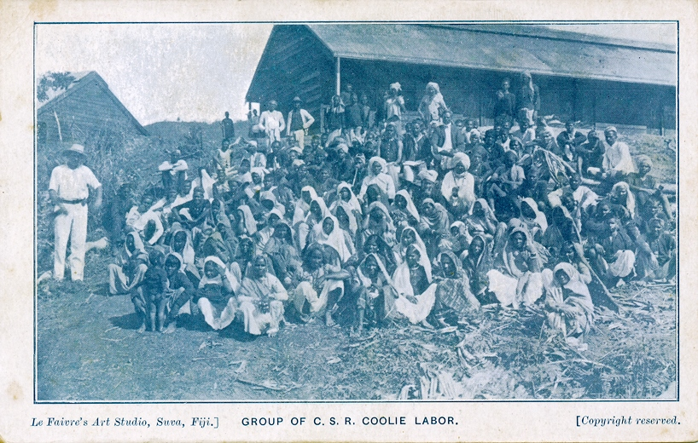
Notes:
The colonial racial and gender stereotypes pervaded the workings of the indenture system and negatively impacted the lives of the labourers in forms of power and control. The labourers (and their dependents) were forced to live in cramped and insanitary accommodations, they received low wages, and their movement off the plantation was heavily restricted due to pass-law regulations. Failure to comply resulted in the labourers’ arrests, and imprisonment with hard labour or a fine.
There was also a skewed sex ratio, with, at the most, 40 women to 100 men, which persisted throughout the indenture period in all the colonies. The imbalance of sexes created tensions within the plantation social system and is thought to have significantly contributed to the high rates of male physical abuse against women, including murders.

Slide 14
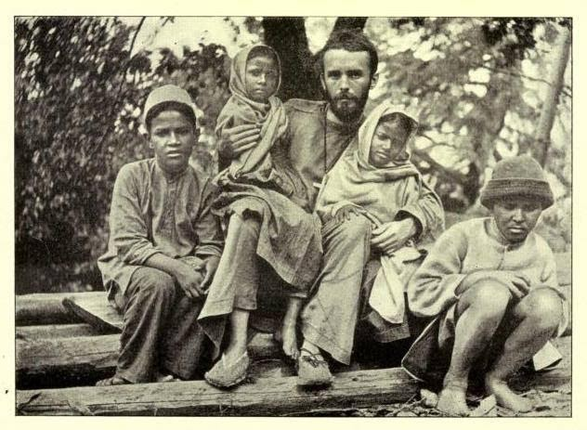
Notes:
The inequitable living and working conditions, which lay at the intersections of colonial rule and the colonial plantocracy, persisted throughout the indentured era. Even in the final indentured colony, Fiji, where indenture was introduced 46 years after the initiation of the system, there were high rates of suicide, brutality against women, and morbidity and mortality due to systemic inadequacies on the plantations.

Slide 15
With Gandhi at the Embassy of India, Panama
Notes:
Statistics show that the rate of suicide among the labourers in Fiji was 20 times higher than that prevalent in their homeland in India, and worse than in any other British colony which used Indian indentured labour.
The suicide rate in Fiji for indentured labourers between 1902-1912 was 926 per million compared to 147 for free men, and 63 for Uttar Pradesh, the province from which most of the immigrants had come. The death rate for indentured labourers in 1913 was 22.7 per 1000 compared to 10.7 for free Indians. According to a report from C.F. Andrews, most of the suicides were committed between 3 and 4 am, when labourers were awakened by a bell to begin their day. This tells us something.

Slide 16
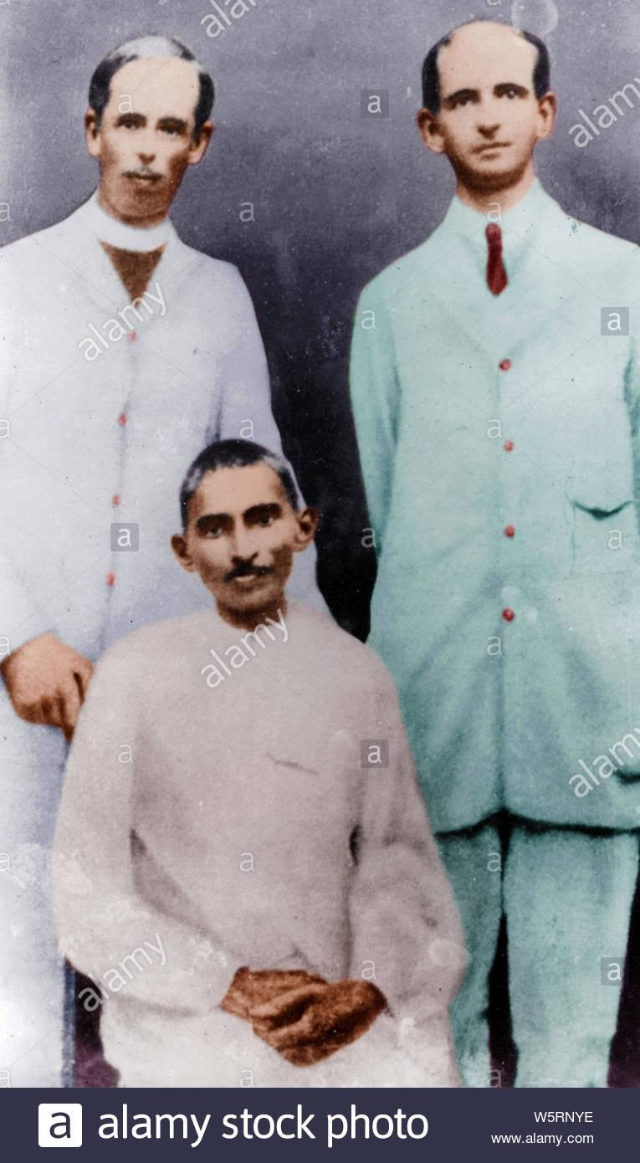
With Gandhi and W.W. Burton
Notes:
Hugh Tinker, in his book A New System of Slavery argues that it was public opinion in India that was responsible for bringing indenture to an end, and the person who can be credited for this is Mahatma Gandhi.
Gandhi sent Charles Freer Andrews, a good friend, to Fiji to carry out an independent inquiry into the conditions of Indian indentured labourers in Fiji.
C.F. Andrews came to Fiji with a fellow missionary, William Pearson, and it was their report, known as the Andrews report, on the social injustices of the indenture system that finally moved the imperial Government of India to bring the indenture system in Fiji to an end in 1916.

Slide 17
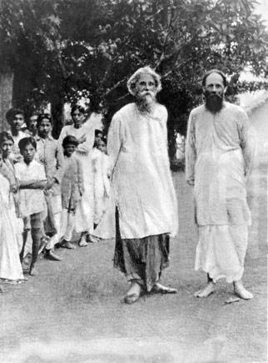
Notes:
In its annual report, the CSR Company accused Rev Andrews of working in league with politicians in India who were undermining the British Raj there. Later, under pressure from the Fiji government, India decided to revise its decision to end indenture immediately and let it continue for another five years before it was brought to an end.
Hearing the news, Gandhi sent Andrews back to Fiji for further investigations. Meanwhile, under Gandhi, a vigorous campaign was mounted in India against indenture. In Fiji, Andrews lived with the Indians so that he could gather firsthand information on the system.
Armed with this, on his return to New Delhi, he confronted the Secretary of State for India. Confronted with the evidence, the Indian Government decreed that the system should be abolished.

Slide 18
With Gandhi at Marseilles in France 1931
Notes:
What was the portrayal of the labourers in the report?
Andrews blamed indenture as a degenerating force, and saw it as the machinery behind the moral degradation of the indentured Indians. Andrews blamed this moral degradation on the lack of privacy of the lines, the disproportionate sex ratio, the loss of cultural norms and practices of the Indian village, and the lack of recognition of the Indian marriages by the European authorities. To this needs to be added the culpability of the European overseers, the Indian sardars, and the complicity of the indenture processes, such as the courts, where offences against the plantation authorities were more often than not dismissed.

Slide 19
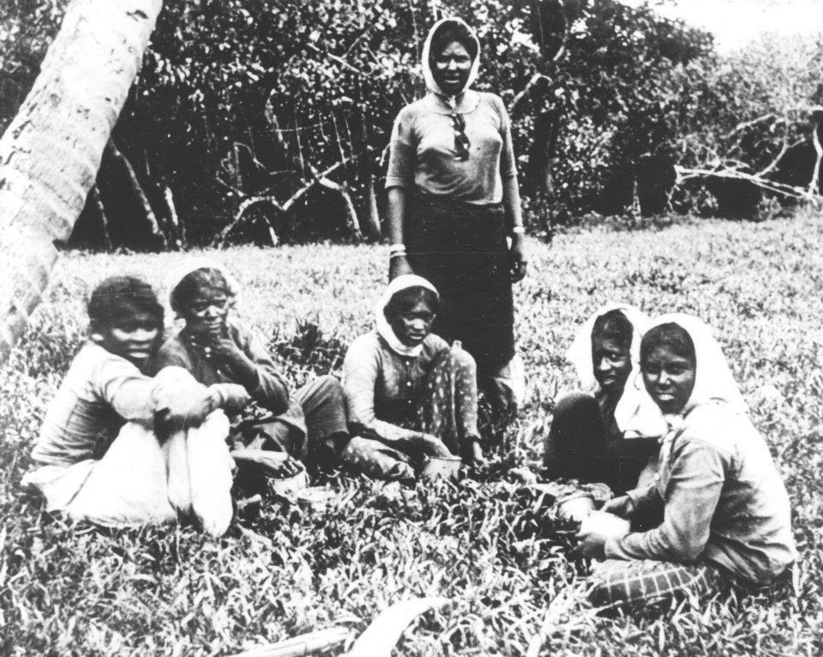
Notes:
Women in indenture: A major emphasis in the abolitionist discourse
The colonial discourse portrayed women as scheming and apathetic wives and mothers, who were responsible for the violence and suicide rates amongst the male labourers. With a ratio of 10 women to 40 men, women were a minority on the plantations and were blamed for the interpersonal violence amongst males that permeated the plantation strata, as well as male suicide rates. Within the colonial records, the attributed cause to these acts of self-inflicted and interpersonal violence was sexual jealousy and the mercenary behaviour of women. However, the reality was not so clear cut.
A re-evaluation of plantation-based incidents demonstrates that women were particularly discriminated against on the plantations, as workers, as females and as mothers. In the heavily male-dominated society, women were not given paid positions of authority, as in the position of Sirdar. Furthermore, although the indenture contract guaranteed a minimum wage of 1 shilling for men and nine pence for women, the employers imposed on the labourers a task system, in which they were paid according to the type of work that they performed. Thus, indentured women, whose work involved weeding, hoeing and planting of cane earned less than men, whose tasks included the long hours of harvesting of sugar cane, and women who were without a male partner were even more hard pressed to survive (Hassankhan, 2014).

Slide 20
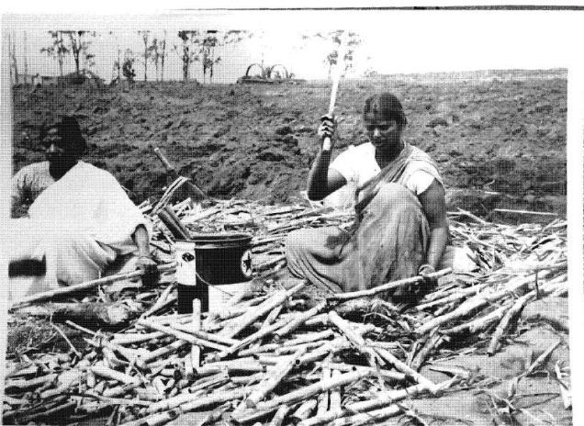
Notes:
Moreover, in addition to their plantation work, women were housewives and mothers, who had to perform household tasks at dawn, prior to leaving for their plantation work and in the evenings, upon their return from the plantation.
As females, the women were subject to oppression, murder, violence and sexual assault at the hands of plantation authorities and male labourers. The pivotal examples within the Indian nationalist newspapers of two women labourers, Naraini and Kunti, as ‘women defending their honour (izzat)’ in an inhospitable environment away from home drew attention and sympathy for all Indian indentured women, and helped counter the colonial representation of indentured women as sexual mercenaries.
In addition to the sexual commodification of women, there was the plantation authorities’ perception of women as labourers-before-mothers. Women were expected to return to the field soon after giving birth, despite colonial report recommendations. Women were also forced to return to work due to the low wages of their partners.

Slide 21
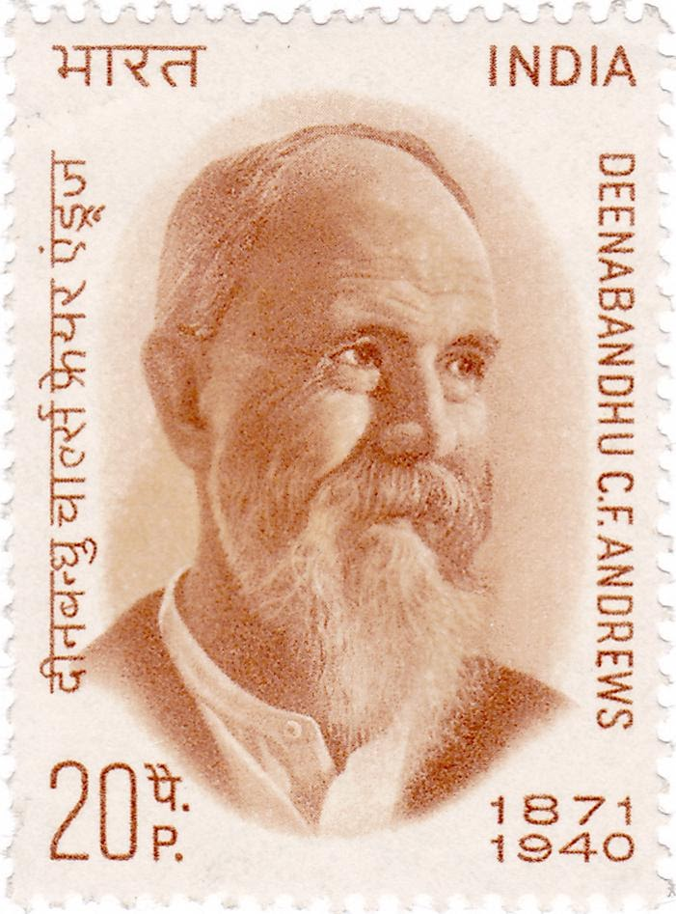
Notes:
Conclusion
As this presentation has shown, despite the Indian indenture system’s initial endorsement as an improvement on slavery, there were endemic failings within the system, that were brought to the public’s attention largely due to the efforts of C.F. Andrews (1918). And it was the Indian people's opinions in the newspapers that is believed to have played a crucial role in abolishing the indentured practices in the colonies.
As a result of C.F. Andrews’ work, the recruitment of Indian indentured labourers was abolished from 1916. In Fiji, the final shipload of 888 indentured labourers arrived on the steamship Sutlej, on 11 November, 1916. All outstanding indenture contracts were completed or cancelled on 1st January, 1920.
Today, The migration of people under Indian indenture, the subsequent establishment of diasporic communities around the world, the languages and cultures that ties these communities together over vast distances has been recognised by UNESCO as a significant world memory. There is the UNESCO-recognised indentured labour route project, which seeks to increase knowledge about indentured labour and the people who lived and worked under the system. And, we recognize people like C.F. Andrews for making a universal difference in his fight for social justice for the indentured labourers.

Slide 22
References
Ali, Ahmad. 2004. Girmit: Indian Indenture Experience in Fiji. Suva, Fiji: Fiji Museum; Ministry of National Reconciliation and Multi-Ethnic Affairs.
Andrews, Charles Freer and Pearson, Walter Washington. 1916. Indentured Labour in Fiji: An Independent Enquiry. Calcutta: Anti-Indenture League.
Batsha, Nishant. 2017. The Currents of Restless Toil: Colonial Rule and Indian Indentured Labor in Trinidad and Fiji. (Doctoral dissertation, Columbia University).
Cole, Anthony. 2000. Accidental deaths on Fiji plantations, 1879-1916. In B.V. Lal (Ed.), Chalo Jahaji: On a Journey through Indenture in Fiji. Suva, Fiji: 324-360.
Fowler, Glenn. 2000. A want of care: Death and disease on Fiji plantations, 1890-1900. In B.V. Lal (Ed.), Chalo Jahaji: On a Journey through Indenture in Fiji. Suva, Fiji: 273-290.
Gillion, Kenneth. L. 1962. Fiji’s Indian Migrants: A History to the End of Indenture in 1920. Melbourne: Oxford University Press.
Gounder, Farzana. 2020. Motherhood performativity in sub-altern life stories. In A. Pande (Ed.). Women in the Indian Diaspora: Indentured and Post-indentured Experiences. Singapore: Springer: 21-35.
Gounder, Farzana. 2011. Indentured Identities: Resistance and Accommodation in Plantation-era Fiji. The Netherlands: John Benjamins.
Gounder, Farzana. 2014. Who is ‘we’? Anniversary narrative as collective memory. In E. Stracke (Ed.), Intersections: Applied linguistics as a Meeting Place. Newcastle upon Tyne, UK: Cambridge Scholars Publishing: 87-109.
Gupta, Charu. 2020. Indentured women and Hindi print-public sphere in early twentieth century India. In F. Gounder., K. Hiralal., A. Pande., & M. S. Hassankhan (Eds.). Women, Gender and the Legacy of Slavery and Indenture. Manohar/Routledge: 101-120.
Harvey, Jane. (2000). Naraini’s Story. In B. V. Lal (Ed.), Chalo Jahaji: On a journey through indenture in Fiji (pp. 337-48). Canberra: Division of Pacific and Asian History, The Australian National University; Suva: The Fiji Museum.
Kale, Madhavi. 2010. Fragments of Empire: Capital, Slavery, and Indian Indentured Labor in the British Caribbean. University of Pennsylvania Press.
Notes:
References

Slide 23
References
Lal, Brij V and Munro, D. 2014. Non-resistance in Fiji. In M.S. Hassankhan, B.V. Lal, & D. Munro (Eds.), Resistance and Indian Indenture Experience: Comparative Perspectives. New Delhi: Manohar Publishers: 121-156.
Lal, Brij V. 2000. Origins of the girmityas. In B.V. Lal (Ed.), Chalo Jahaji: On a Journey through Indenture in Fiji. Suva, Fiji: 9-119
Lal, Brij V. (1983). Girmitiyas: The origins of the Fiji Indians. Canberra: Journal of Pacific History Monograph.
Lal, Brij V. (1985). Kunti's cry: Indentured women on Fiji plantations. The Indian Economic & Social History Review, 22(1), 55-71.
Lal, Brij. V. and Munro, Doug. 2014. Non-resistance in Fiji. In M. S. Hassankhan., B. V. Lal, and D. Munro (Eds.), Resistance and Indian indenture experience: Comparative perspectives (pp. 121-156). New Delhi: Manohar Publishers.
Macaulay, Thomas Babington. 1835. Minute on Indian education. The Post-colonial Studies Reader: 428-430.
McNeill, James. (1914). Report on the condition of Indian immigrants in the four British colonies: Trinidad, British Guiana or Demerara, Jamaica and Fiji, and in the Dutch Colony of Surinam or Dutch Guiana, Part II: Surinam, Jamaica, Fiji and general remarks. Simla: Government Central Press.
Metcalf, Thomas R. 1997. Ideologies of the Raj (Vol. 3). Cambridge University Press.
Naidu, Vijay. 2004. The violence of indenture in Fiji (2nd ed). Lautoka, Fiji: Fiji Institute of Applied Studies.
National Farmers Union. Children of the Indus, 1879-2004: A history of Indians in Fiji portraying the struggles of an immigrant community for justice, equality and acceptance. National Farmers Union, Fiji.
Northrup, David. (1995). Indentured labor in the age of imperialism,1834-1922. Cambridge: Cambridge University Press.
Sanadhya, Totaram. (1914/1973). Fiji Dwip men Mere Ikkis Varsh [My Twenty-one years in Fiji]. Varanasi: Banarsi das Chaturvedi. [First published 1914]. Agra: Shivlal Aggrawal and Company.
Shameem, Shaista. (1990). Sugar and spice: Wealth accumulation and the labour of Indian women in Fiji, 1879-1930 (Doctoral dissertation, University of Waikato).
Shameem, Shaista. 1987. Gender, class and race dynamics: Indian women in sugar production in Fiji. Journal of Pacific Studies, 13: 10–35.
Thiara, Ravinder K. (1995). Indian indentured workers in Mauritius, Natal, and Fiji. The Cambridge survey of world migration, 63-68.
Tinker, Hugh. 1974. A New System of Slavery: Immigration of Indentured Labour from India. London, Widenfeld and Nicolson.
Vahed, Goolam and Desai, Ashwin. 2012. Indian Indenture: Speaking across the oceans. Man in India, 92(2): 195-213.

Slide 24
Farzana Gounder IPU New Zealand Tertiary Institute New Zealand Email: fgounder@ipu.ac.nz Website: farzanagounder.com

